Slide 2
Computational approaches for the therapeutic target discovery to ame-liorate muscle wasting during aging and disease
Msc Karen Guerrero Vazquez
Dr. Katarzyna Whysall
Dr. Pilib O Broin

Slide 4


Slide 5
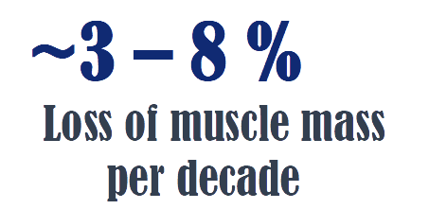

Slide 6
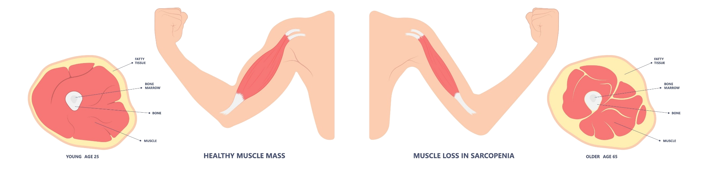

Slide 7
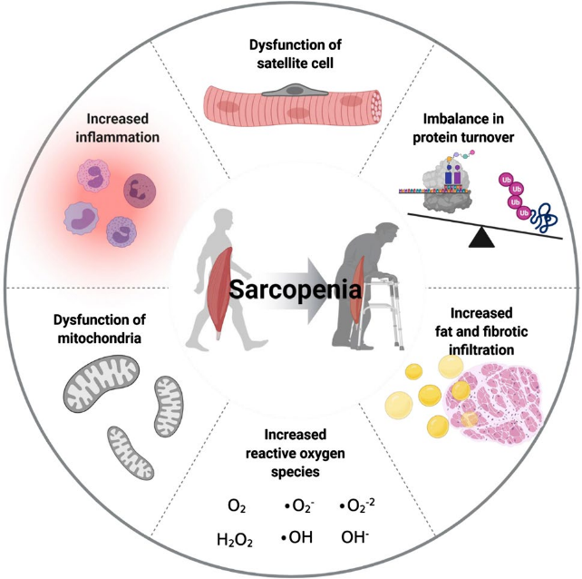

Slide 8
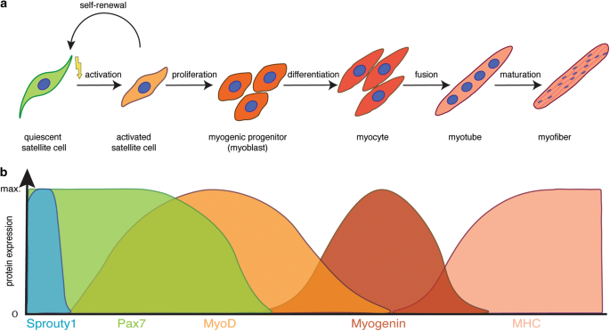

Slide 9
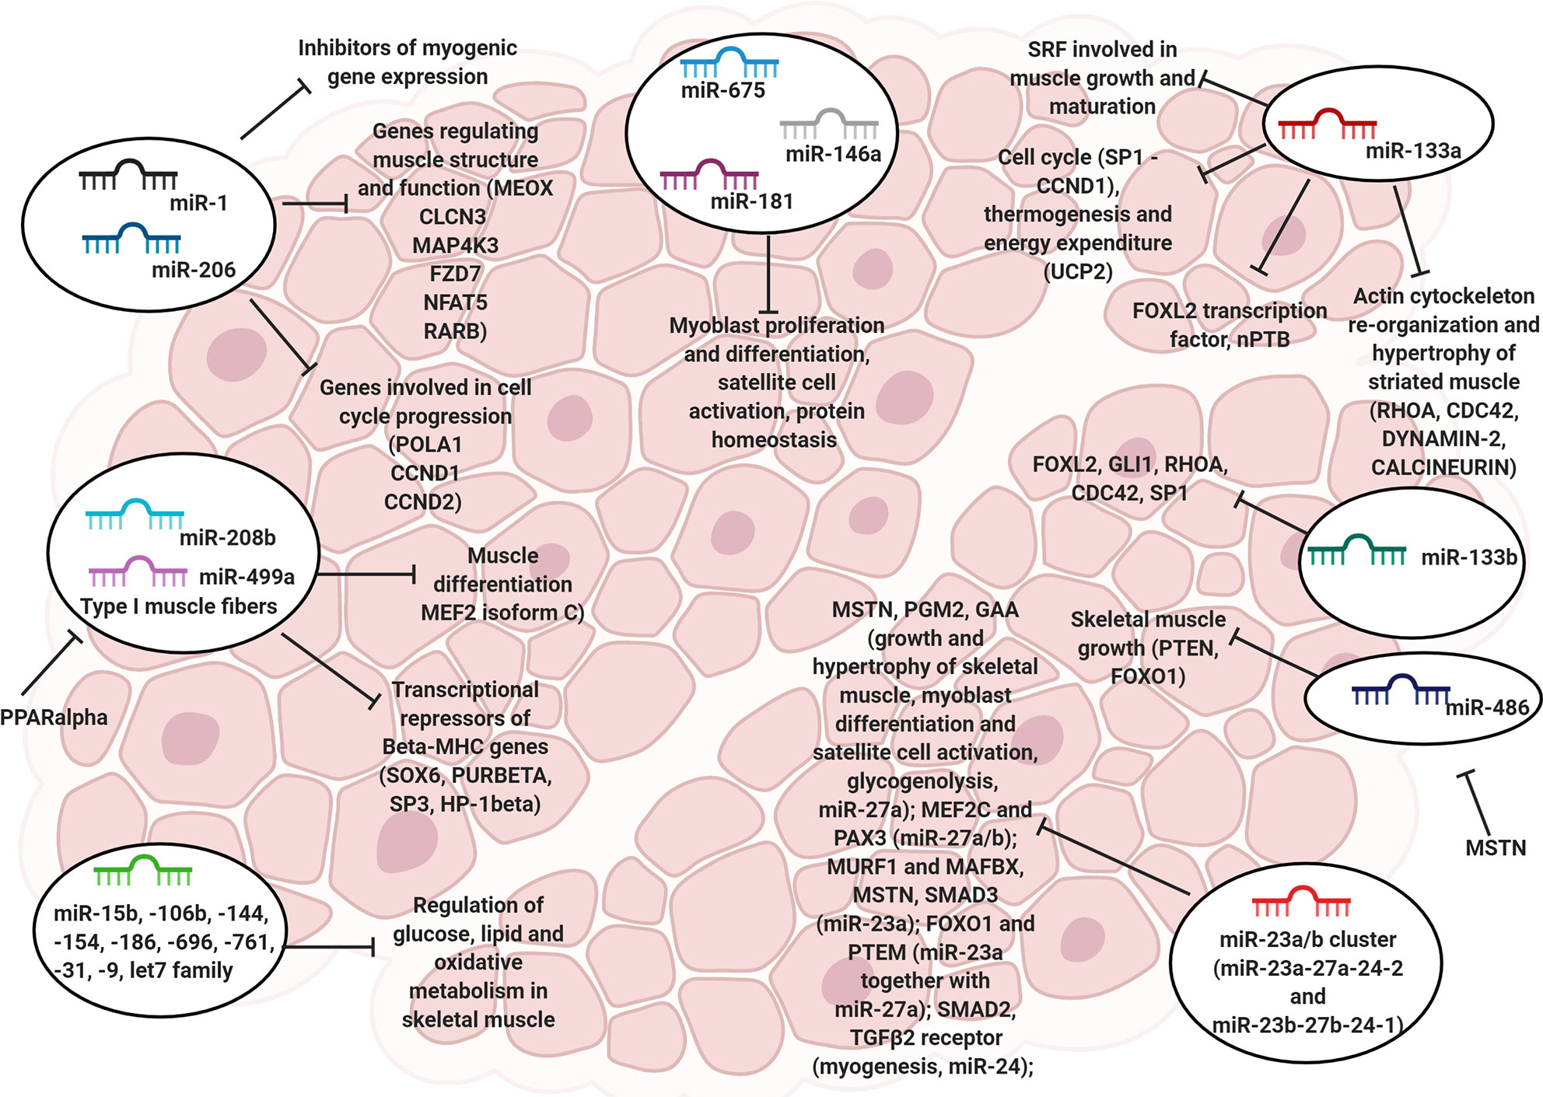

MicroRNA (miRNAs)

Slide 10
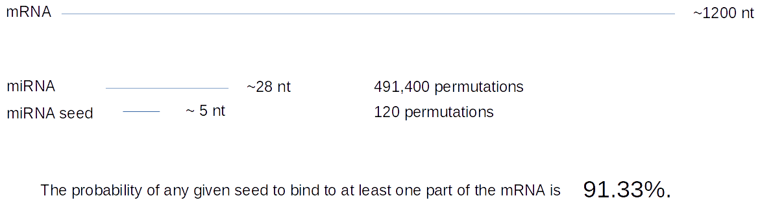
MicroRNA (miRNAs)

Slide 11
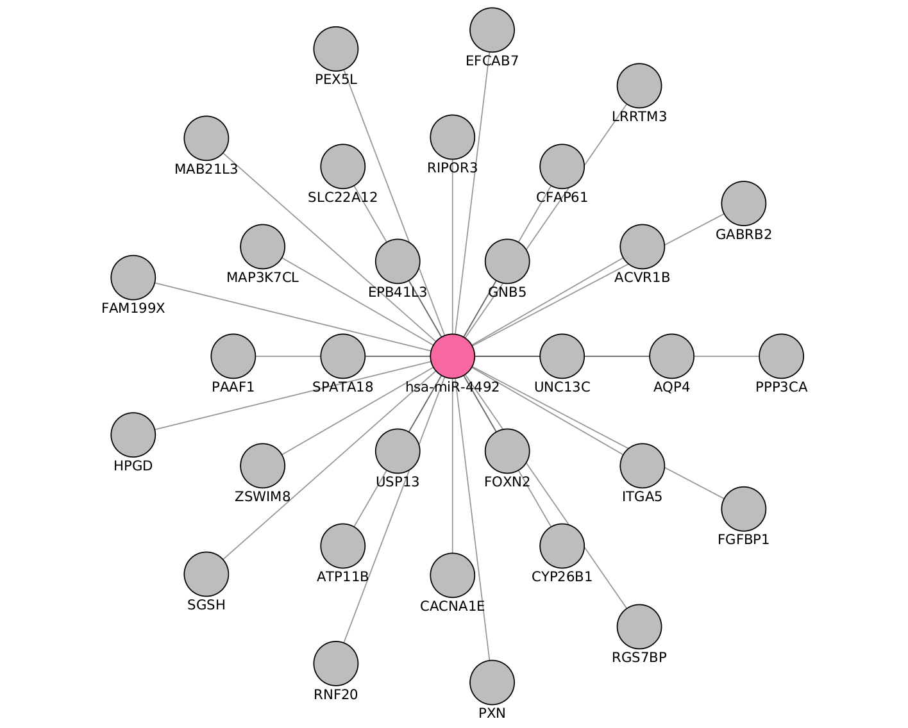
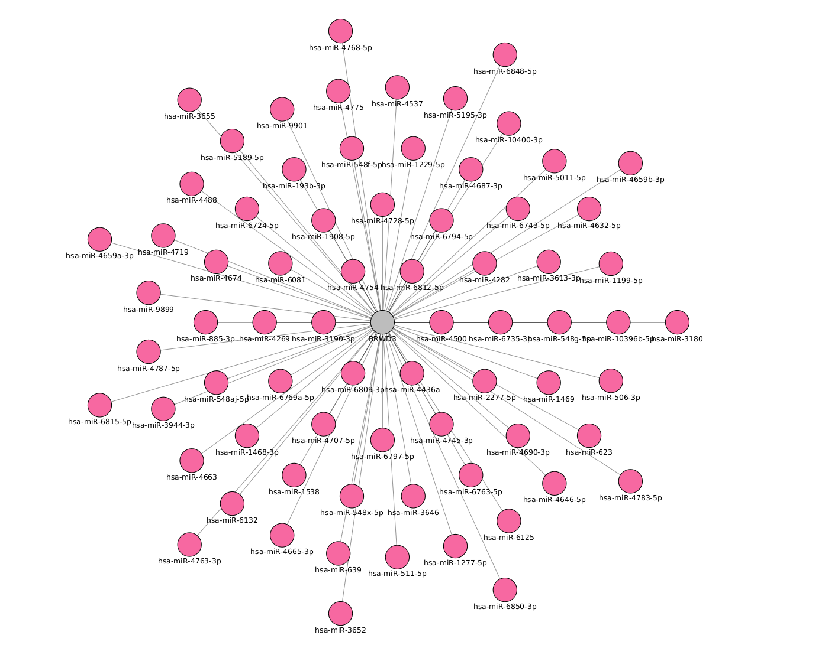

Slide 12
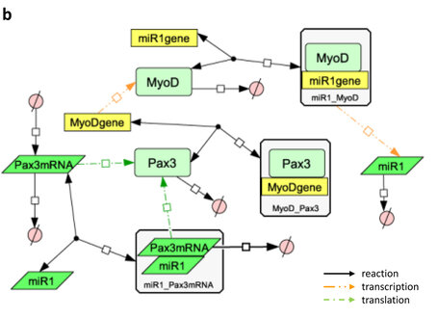
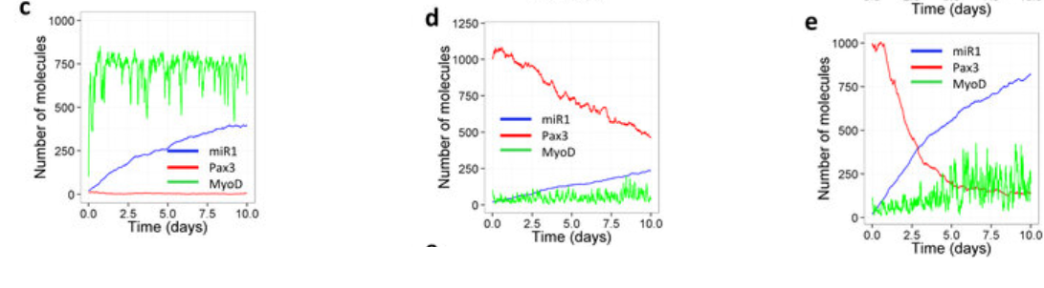
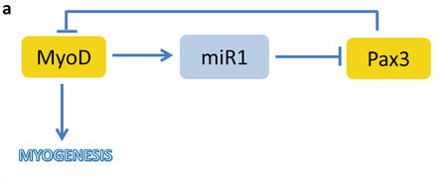

Slide 13
Chapters
Differential analysis: muscle during time
MiRKat DB; An integrated database for microRNAs
miRKat; Algorithms for the selection of microRNA targets
Bonus:
Execution of selected microRNAs in vitro (?)

Slide 14
Target | Type | N.Experiments | Healty | non-healty
mRNA | RNASeq | 3 | 3 | 0
 | MicroArray | 4 | 2 | 2
miRNA | MicroArray | 2 | 2 | 0
 | miRSeq | 1 | 0 | 1

Slide 15
Experiments
GEO number | Samples | Min Age | Max Age | Reference
GSE152558 | 5 | 41 | 85 | Tharakan, R., Ubaida-Mohien, C., Piao, Y., Gorospe, M., & Ferrucci, L. (2021).
GSE164471 | 53 | 34 | 80 | Tumasian III, R. A., Harish, A., Kundu, G., Yang, J. H., Ubaida-Mohien, C., Gonzalez-Freire, M., ... & Ferrucci, L. (2021).
GSE157585 | 136 | 19 | >65 | Kulkarni, A. S., Peck, B. D., Walton, R. G., Kern, P. A., Mar, J. C., Windham, S. T., ... & Peterson, C. A. (2020).
GSE87105 | 16 | 30 | 78 | Mercken, E. M., Capri, M., Carboneau, B. A., Conte, M., Heidler, J., Santoro, A., ... & de Cabo, R. (2017)..

Slide 16
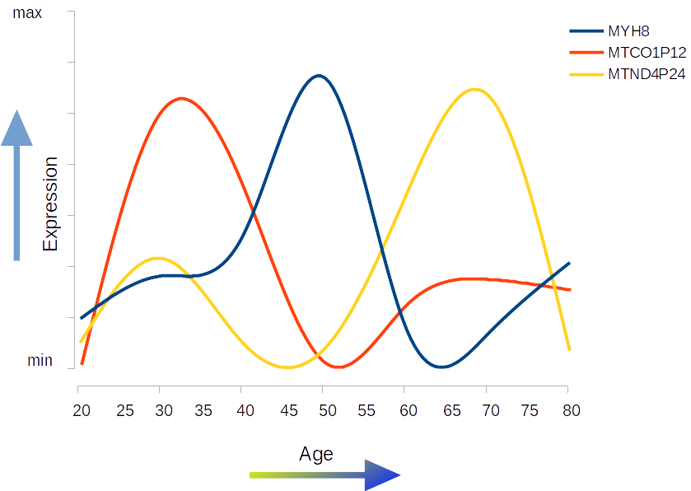




Slide 18
Thank You

Slide 19
Acknowledgements
This presentation has emanated from research conducted with the financial support of Science Foundation Ireland under Grant number [18/CRT/6214 ]

